Slide 1
Structural Technical Report #4: Lateral System Analysis Study
James w. & Frances C. McGlothlin Medical Education Center

Slide 2
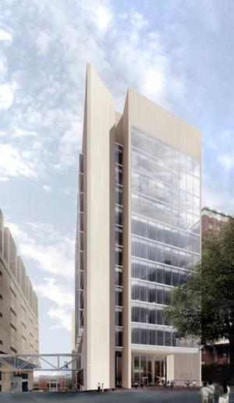
James W. & Frances C. McGlothlin Medical Education Center
Location: Richmond, VA
Owner: Virginia Commonwealth University
College: School of Medicine
Type: Multipurpose Education Facility
Functions: Administrative/Classrooms/Research
Size: 220,000 GSF
Height: 13 Stories (above ground)
Schedule: October 2009 to March 2013
Cost: $159 million
LEED: Designed for Silver Certification

Slide 3
RAM Model Overview
Frames Modeled – Base conditions – Diaphragm –
Special Considerations – Distribution of Forces

Slide 4
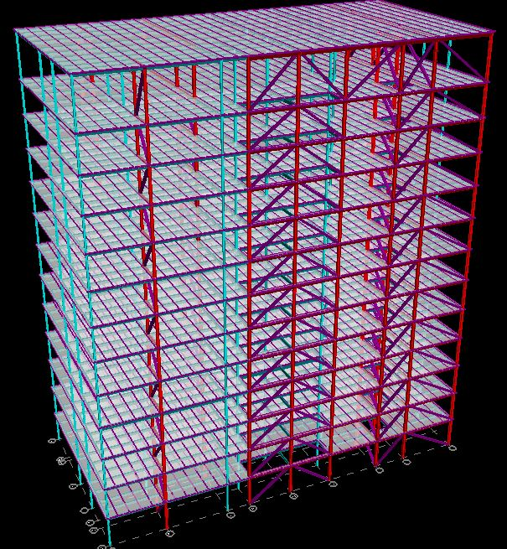

Slide 5
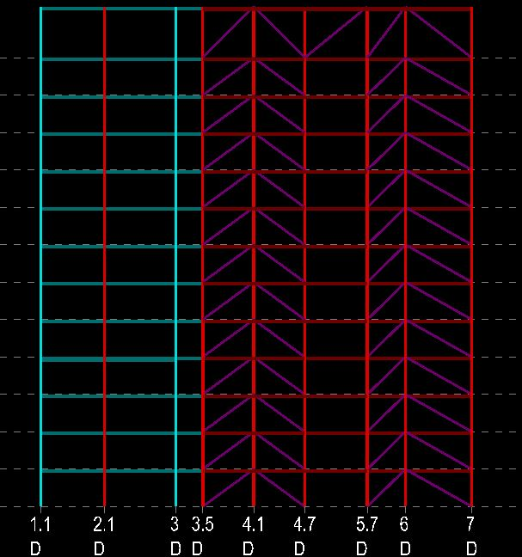

Slide 6
RAM Model Overview
Base Conditions –
Columns fixed at base
All seven frames assumed to originate at Ground Level
Diaphragm Type –
Floor diaphragms considered to be rigid
Special Considerations –
Model was simplified from building plan
Only lateral elements were considered in analysis

Slide 7
WIND – case 1
Floor | Height Above Ground | Load - X (k) | Load - Y (k)
Roof | 196’ - 0” | 21.23 | 40.86
13 | 176’ - 0” | 36.32 | 70.05
12 | 161’ - 4” | 30.13 | 58.30
11 | 146’ - 8” | 29.55 | 57.36
10 | 132’ - 0” | 28.93 | 56.34
9 | 117’ - 4” | 28.25 | 55.25
8 | 102’ - 8” | 27.51 | 54.04
7 | 88’ - 0” | 26.69 | 52.71
6 | 73’ - 4” | 25.77 | 51.21
5 | 58’ - 8” | 24.69 | 49.46
4 | 44’ - 0” | 23.40 | 47.35
3 | 29’ - 4” | 21.72 | 44.62
2 | 14’ - 8” | 19.91 | 41.68

Slide 8
Seismic
Floor | Height Above Ground | Load - Both X & Y (k)
Roof | 196’ - 0” | 71.1
13 | 176’ - 0” | 116
12 | 161’ - 4” | 87.1
11 | 146’ - 8” | 74.1
10 | 132’ - 0” | 62.0
9 | 117’ - 4” | 50.7
8 | 102’ - 8” | 40.4
7 | 88’ - 0” | 31.1
6 | 73’ - 4” | 22.8
5 | 58’ - 8” | 15.6
4 | 44’ - 0” | 9.6
3 | 29’ - 4” | 4.9
2 | 14’ - 8” | 1.5

Slide 9
Results from RAM Model
Wind & Seismic analysis

Slide 10
Animation - Wind Loads (CASE 1)

Slide 11
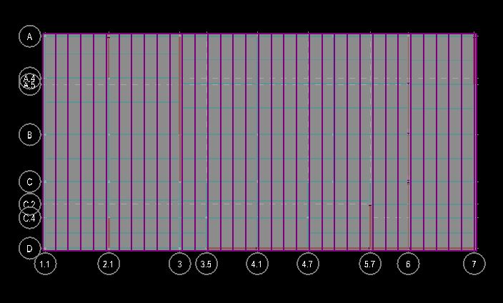
Moment Diagram - frame 2

Slide 13
Member Utilization % - Frame 2

Slide 14
Member Utilization % - Frame 2
Floor | Column 1 | Column 2 | Brace
13 | 0.017 | 0.11 | 0.14
12 | 0.26 | 0.11 | 0.20
11 | 0.26 | 0.57 | 0.5
10 | 1.1 | 0.57 | 0.70
9 | 1.1 | 1.6 | 0.86
8 | 2.3 | 1.6 | 1.0
7 | 2.4 | 3.2 | 1.2
6 | 4.1 | 3.2 | 1.3
5 | 4.1 | 5.1 | 1.4
4 | 6.0 | 5.1 | 1.4
3 | 6.1 | 6.1 | 0.07
2 | 7.2 | 6.1 | 1.4
1 | 7.9 | 7.2 | 1.4

Slide 15
Conclusions
Is Lateral System acceptable?
Serviceability:
Allowable Drift -
Wind - 0.6” @ Roof > 0.56” (CASE 1) $∴$OK
Wind - 0.4” @ all other Floors > 0.38” (CASE 1) $∴$OK
Seismic - 2.9” @ all Floors > 0.91” $∴$OK
Strength:
X-Direction - Seismic Controls
Column - W14x233 ½ pPr + 9/8bM = 0.72<1.0 $∴$OK
Brace - W12x65 144k < 290k allowable$∴$OK
Y-Direction - Wind Controls
Column - W14x455 pPr + bM = 0.79<1.0 $∴$OK
Brace - W12x120 350k < 700k allowable $∴$OK
Lateral System is acceptable for loads calculated in Technical Report #2

